Slide 1
Chapter 7 Query Processing
Presented by : Er. Lali Manandhar
Assistant Senior Lecturer
Everest Engineering College

Slide 2
Query Processing
Query Processing refers to range of activities involved in extracting data from a database.
Query processing denotes the compilation and execution of a query specification usually expressed in a declarative database query language such as the structured query language (SQL).
The basic steps involved in processing of a query are
1. Parsing and translation
2. Optimization
3. Evaluation

Slide 3
1. Parsing and Translation
The first step in any query processing system is to translate a given query into its internal form.
This translation process is similar to the work performed by the parser of a compiler.
In generating the internal from of the query, the parser check the syntax of the user’s query, verifies that the relation is formulated according to the syntax rules of the query language.
Then this is translated into relational algebra.

Slide 4
2. Optimization
A relational algebra expression may have many equivalent expressions.
We can execute each relation algebra operation by one of several different execute algorithms.
The process of choosing a suitable one with lowest cost is known as query optimization.
Cost is estimated using the statistical information from database catalog.

Slide 5
The different statistical information is number of tuples in each relation, size of tuples etc.
So among all equivalent expressions, choose the one with the cheapest possible evaluation plan (one of the possible way of executing a query).

Slide 6
3. Execution
The query execution engine takes a query evaluation plan, executes that plan and returns the answer to the query.

Slide 7
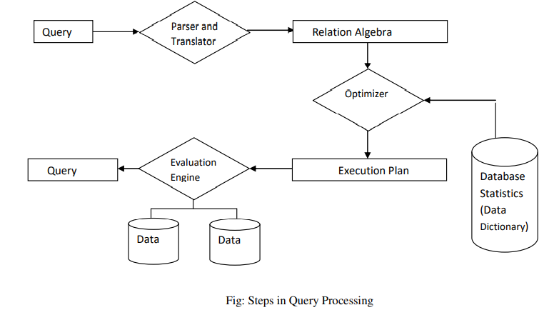

Slide 8
Query Cost Estimation
Each query is translated into a number of semantically equivalent plans.
So there are several alternatives, now the question is which one is the most efficient evaluation plan to be selected for execution.
To get the answer the cost for all alternatives must be estimated and the plan with lowest cost is selected.
Since a database resides on disk, often the cost of reading and writing to disk dominates the cost of processing a query.
We can choose a strategy based on reliable information, database systems may store statistics (metadata) for each relation R.

Slide 9
These statistics includes number of tuples in a relation, size of tuples in a relation etc.
Cost is generally measured as total elapsed time for answering a query.
Many factors contribute to time cost. Some of them are disk accesses, CPU, network communication etc.

Slide 10
Equivalence / Transformation Rules
Two algebraic expressions are said to be equivalent if they produce same result.
By using the equivalence rule which is concerned with basic relational algebra operator, we can formulate any equivalent expressions for a single query.
If R, S and T are relations and C1, C2……Cn are conditions then equivalent rules are:

Slide 11
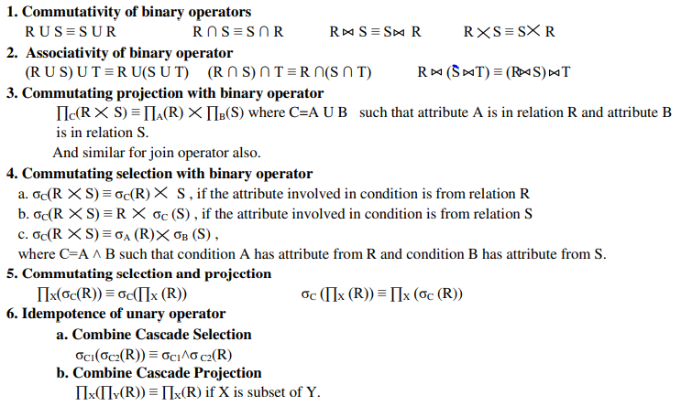

Slide 12
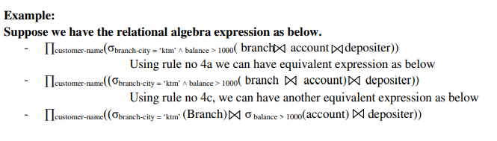

Slide 13
Operator Tree
The relational algebra query can be represented graphically for simplicity by an operator tree.
An operator tree is a tree in which leaf node is a relation stored in the database and a non-leaf node is a intermediate relation produce by a relational algebra operator.
The sequence of operations is directed from leaves to the root, which represents the answer to the query.
Note, Let E1 and E2 be two relation then using rule no 4 (if c has attribute only from E1)

Slide 14
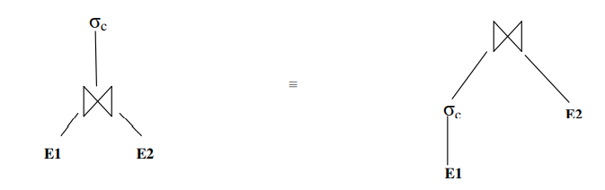

Slide 15
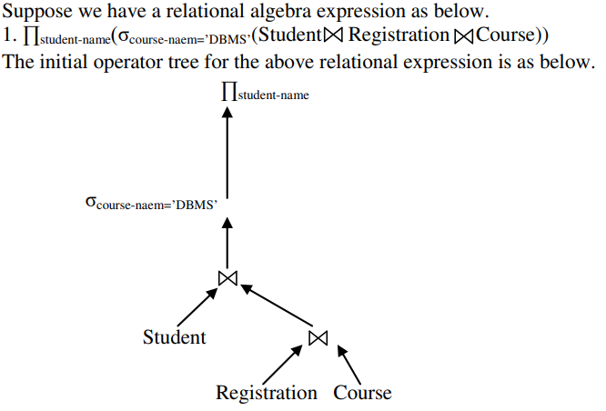
Example:

Slide 16
Query Optimization
It is the process of selecting the most efficient query execution plan among the many strategies possible for processing a query.
The query optimizer is very important component of a database system because the efficiency of the system depends on the performance of the optimizer.
The selected plan minimizes the cost function.
Query optimization refers to the process of producing a query execution plan which represents an execution strategy for the query.
The selected plan minimizes an object cost function.

Slide 17
Steps of optimization
Step 1 − Query Tree Generation
Step 2 − Query Plan Generation
Step 3− Code Generation

Slide 18
Step 1 − Query Tree Generation
A query tree is a tree data structure representing a relational algebra expression.
The tables of the query are represented as leaf nodes.
The relational algebra operations are represented as the internal nodes.
The root represents the query as a whole.
Steps :
1. Create an initial operator (expression) tree.
2. Move select operation down the tree for the easiest possible execution.
3. Applying more restrictive select operation first.
4. Replace Cartesian product by join.
5. Creating new projection whenever needed.
6. Adjusting rest of the tree accordingly.

Slide 19
Example1:
The following query retrieves the customer name from branch city pokhara whose balance is greater then 1000
Select customer-name from Branch, Account, Depositor where city= ‘Pkr’ and balance >1000
To process the above query, there are number of evaluation plan in which the above query can be processed.
1. Join relation Branch and Account, join the result with Depositor and then do the restriction.
2. Join the relation Branch and Account, do the restrictions and then join the result with Depositor.
3. Do the restriction, join the relations Branch and Account, and join the result with Depositor.

Slide 20
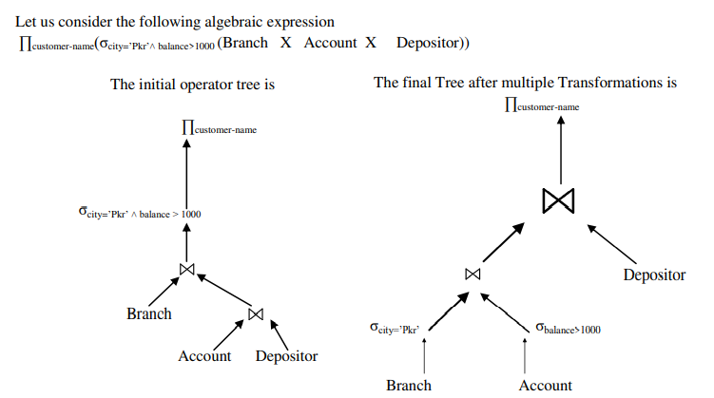
The query optimizer estimates cost for each of the plan and choose the best way to process the query.

Slide 21
Example 2:
Suppose we are given the following table definitions with the certain records in each table.
PROJ (PNO, PNAME, BUDGET)
EMP(ENO, ENAME, TITLE)
ASG(ENO, PNO, DUR)
Write the sql statement and RA expression: “Find the names of employees other than Ram Thapa who worked on CAD/CAM project for either 1 or 2 years”.
Construct initial operator tree and final efficient operator tree after applying transformation rules.

Slide 22
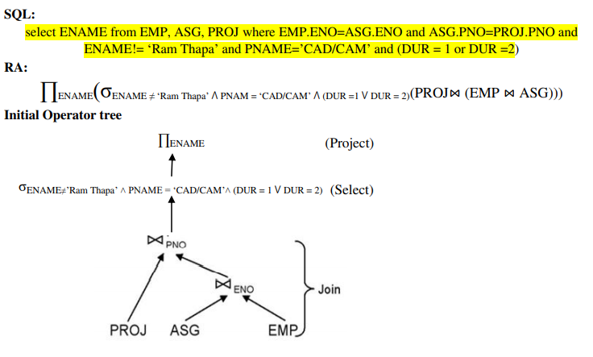

Slide 23
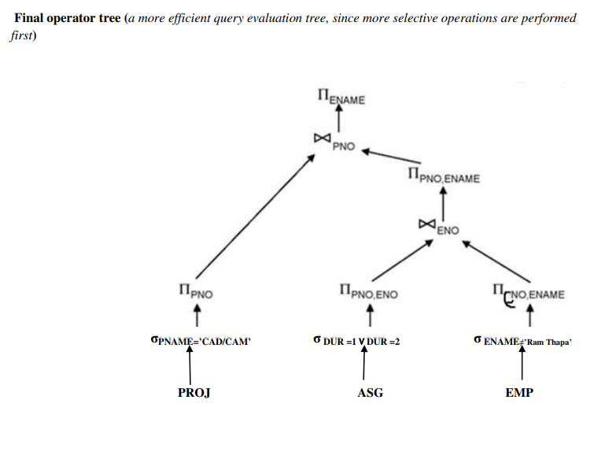

Slide 24
Step 2 − Query Plan Generation
After the query tree is generated, a query plan is made.
A query plan is an extended query tree that includes access paths for all operations in the query tree.
Access paths specify how the relational operations in the tree should be performed.
For example, a selection operation can have an access path that gives details about the use of B+ tree index for selection.
Besides, a query plan also states how the intermediate tables should be passed from one operator to the next, how temporary tables should be used and how operations should be pipelined/combined.

Slide 25
Step 3− Code Generation
Code generation is the final step in query optimization. It is the executable form of the query, whose form depends upon the type of the underlying operating system.
Once the query code is generated, the Execution Manager runs it and produces the results.

